Slide 1
Pinto and the Commodification of Society
Sit in your teams
Session 2.8
Notes:
http://www.linestanding.com/?gclid=CPy02ZvS_NICFYlrfgodrBwNqw
http://www.washingtonexpress.com/services/seatholding.asp
Pinto Fire: https://www.youtube.com/watch?v=lgOxWPGsJNY

Slide 2
Learning Outcomes
Know
Understand the principles of evaluating the moral implications of monetizing a good or service.
Understand the takeaway themes from the Pinto case.
Feel
A desire to a more fully appreciate the things money cannot buy.
Do
Get in the habit of evaluating instances when people (or you) are giving up life for money.

Slide 3
The Commodification of Society

Slide 4

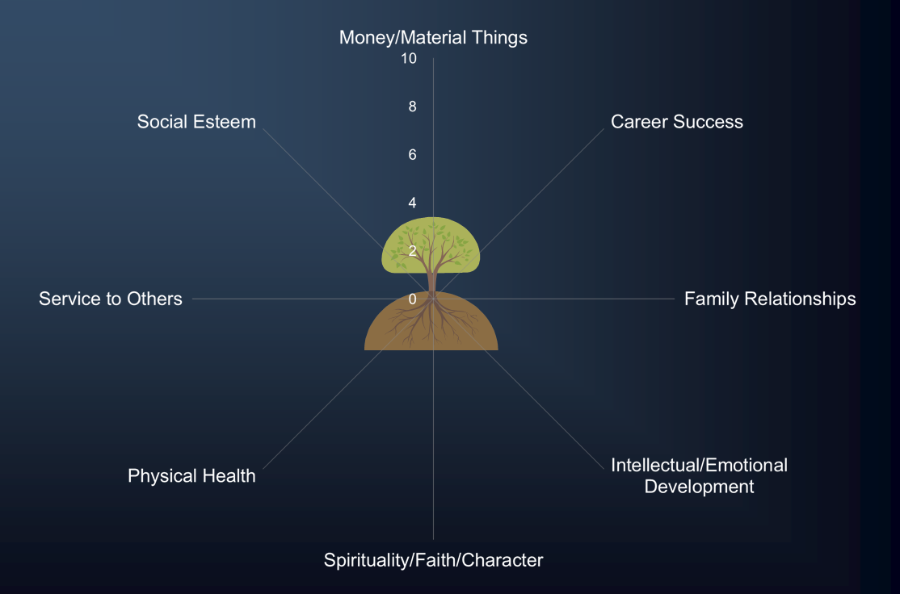
The Mahan Principle
Exchanging
Life
for
Money
Moses 5:30
Notes:
Goods of first intent for goods of second intent.

Slide 5
Market Society
Is there anything money cannot buy?
Market Economy: a tool or means for organizing productive activity (a method for exchanging goods and services).
Market Society: a way of life in which market values seep into every aspect of human endeavor.

Slide 6
Scenario 1
Every summer, the New York City Public Theater puts on free outdoor Shakespeare performances in Central Park. The mission of the Public Theater, a publicly subsidized, nonprofit agency, is to make great theater accessible to a broad audience of New Yorkers. Tickets are available at 1:00pm on the day of the performance. Because of high demand, people line up hours in advance at the box office. Many people are too busy to stand in line for that long, and consequently, a market has emerged for line standers (on Craigslist, etc.). In exchange for queuing up and enduring the wait, line standers charge as much as $125 per tickets to the free performances. What are the implications, good and bad, of this development?

Slide 7
Scenario 1
Pros
  “Linestanding may seem like a strange practice, but it’s ultimately an honest job in a free-market economy.” (Sandel, 23)
  Utilitarian: the fact that the line stander and the payer strike a deal is proof that both parties are better off as a result. By allowing people to make mutually advantageous trades, markets allocate goods to those who value them most highly, as measured by their willingness to pay.
Cons
  Equality/Fairness: It becomes less and less about equal access.
  NY Gov. Cuomo: “Selling tickets that are meant to be free deprives New Yorkers of enjoying the benefits that this taxpayer-supported institution provides.” (Sandel, 22)

Slide 8
Commodify: Is It Right?
Commodifying something needs to consider two factors:
Fairness or Equality: Does it unfairly impact anyone? Does it unfairly coerce? Does it interfere with others’ rights? The focus is on the inequality that market choices may reflect.
Corruption: What are the potential implications? Does it create any social value? Most importantly, does it degrade? Does it treat something with a lower mode of valuation than is appropriate? The focus is on the resulting damage or dissolution that market relations may have on norms and attitudes. (p. 34)
EX: Why can’t we sell kids on eBay?

Slide 9
Scenario 2
Each year, hundreds of thousands of babies are born to drug-addicted mothers. Some of these babies are born addicted to drugs, and a great many of them will suffer child abuse or neglect. Barbra Harris, the founder of a North Carolina-based charity called Project Prevention (www.projectprevention.org) has a market-based solution: offer drug-addicted women $300 cash if they will undergo “permanent birth control” (sterilization). More than three thousand women have taken her up on the offer since she launched the program in 1997. What are the pros and cons of this practice?

Slide 10
Scenario 2
Pros
  It is a voluntary arrangement between private parties. Who are we to get involved?
  Prevents kids from being born into terrible situations.
  Others?
Cons
  Offering drug addicts a financial inducement to give up their reproductive capacity amounts to coercion, especially since the program targets vulnerable women in poor neighborhoods.
  Rather than help recipients overcome their addiction, the money actually subsidizes it.
  Bribery: like bribery, it’s not about the freedom of choice, it’s that it consists in buying and selling something that should not be up for sale.

Slide 11

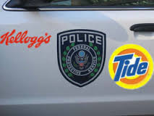
Scenario 3
You work for a revenue-strapped city and are approached by Government Acquistions, a company out of North Carolina. They are offering to provide fully-equipped police cars, complete with lights and communications equipment for $1 a year. The offer comes with a small condition: the cars would be covered, NASCAR-style, with ads and commercial logos. What are the implications?

Slide 12
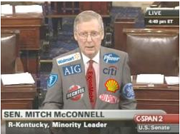
Scenario 3
Pros:
The city will save $28,000/year.
More community safety.
Cons:
Potential favoritism toward sponsors.
Demeans the dignity and authority of law enforcement.

Slide 13
Pinto Case

Slide 14
Pinto Case
The Numbers
$11
$200,000, $67,000
180
180
$137 million
$49.5 million
Cost to fix defect per car
Est. value of each life and injury
Number of lives saved
Number of burn injuries prevented
Total for design change
Total liability for death, injury, and car damage liability.

Slide 15
Pinto Case
Major Question
  “Should a cost/benefit analysis be used in situations where a defect in design or manufacturing could lead to death or serious bodily harm?”

Slide 16
Pinto Case
Other Issues
  Information overload
    Overworked employees
  The darkside of goal-setting
    $2000, 2000 lbs.
  “Safety doesn’t sell.”
    Demand vs. moral obligations
  Typical vs. Atypical problems
    Lacking specific moral scripts

Slide 17
Take Aways
Be able to evaluate the moral implications of commoditizing a good or service:
  Fairness/equity and potential for corruption
Be familiar with moral implications of the Pinto Fires case and the reasons why D. Gioia failed to recall the Pinto (from the reading).

